Slide 1


How to really use Copilot Pro Part 1

Slide 2

“Every pilot needs a co-pilot, and let me tell you, it is awful nice to have someone sitting there beside you, especially when you hit some bumpy air.”
- Eric Wald

Slide 3



Notes:
https://www.flyfrontier.com/

Slide 4

Getting Copilot pro

Slide 5
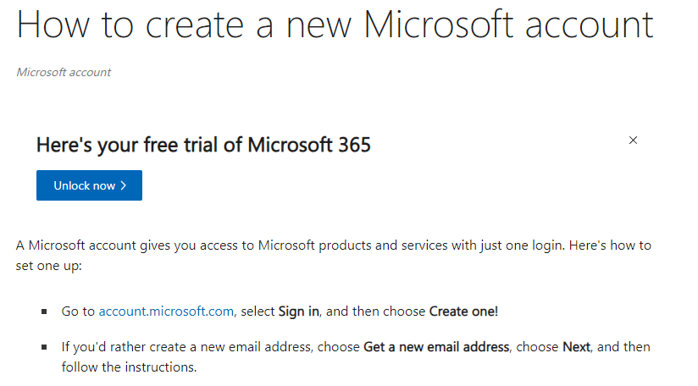
Make sure you have a Microsoft Account
Notes:
https://support.microsoft.com/en-us/account-billing/how-to-create-a-new-microsoft-account-a84675c3-3e9e-17cf-2911-3d56b15c0aaf

Slide 6
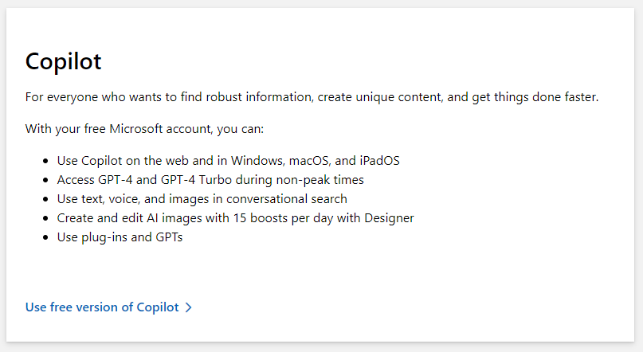
Free Version of Copilot
Notes:
https://www.microsoft.com/en-us/store/b/copilotpro

Slide 7
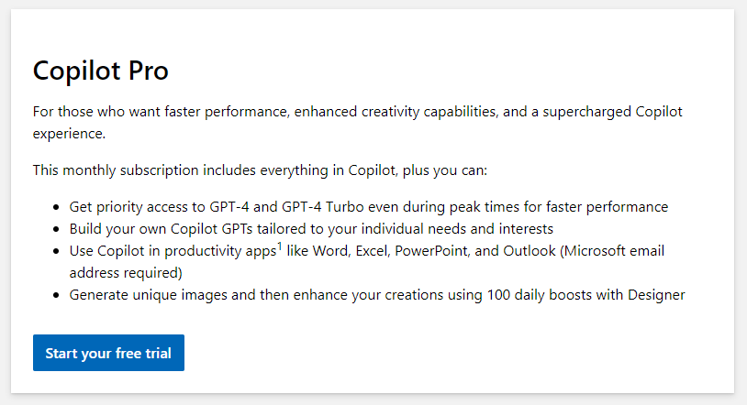
Copilot Pro
Notes:
https://www.microsoft.com/en-us/store/b/copilotpro

Slide 8
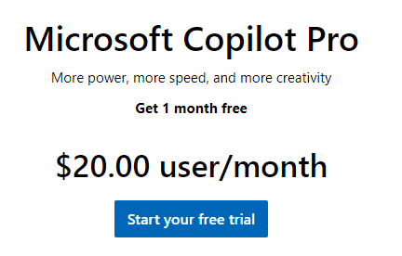
Copilot Pro Cost
Notes:
https://www.microsoft.com/en-us/store/b/copilotpro

Slide 9
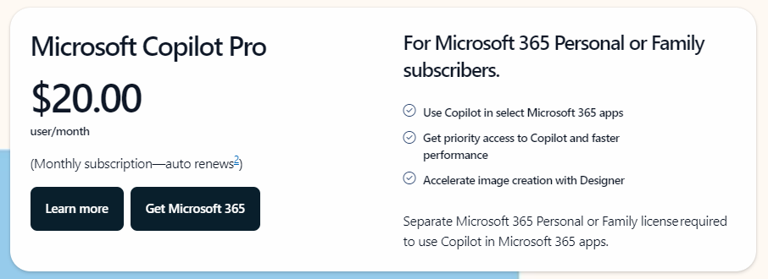
Get office 365
Notes:
https://www.microsoft.com/en-us/microsoft-365/microsoft-copilot

Slide 10
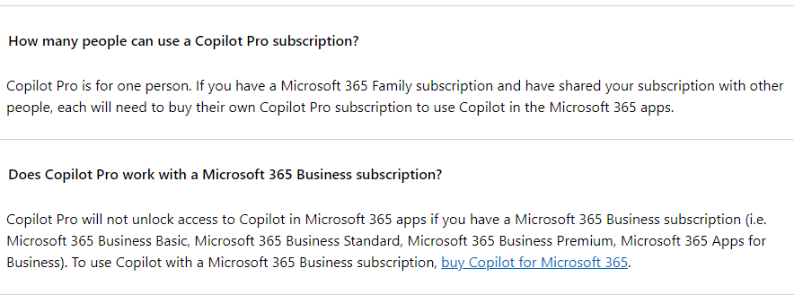
Notes:
https://www.microsoft.com/en-us/store/b/copilotpro

Slide 11

A Tale of two copilots

Slide 12
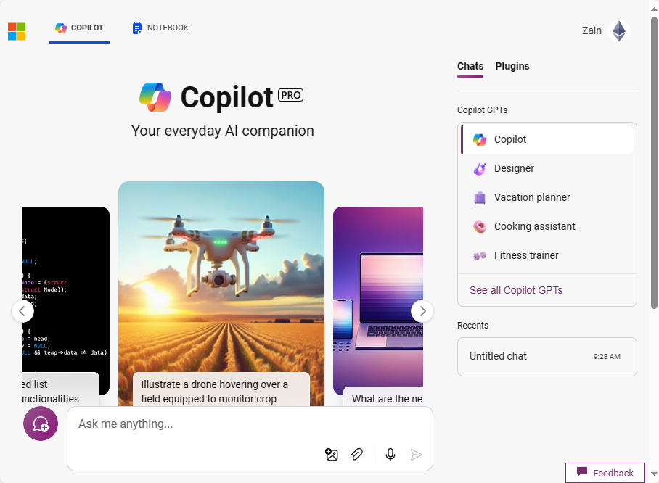
“regular” Copilot

Slide 13
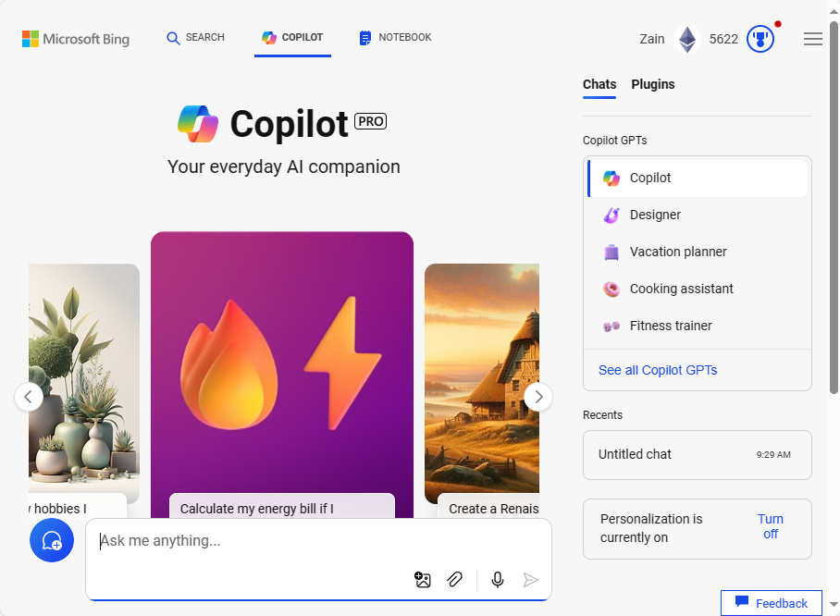
“Bing” Copilot

Slide 14

Vision

Slide 15

Identification

Slide 16

Abstract Ideas

Slide 17

Medical

Slide 18

Chemistry

Slide 19

Electronics

Slide 20
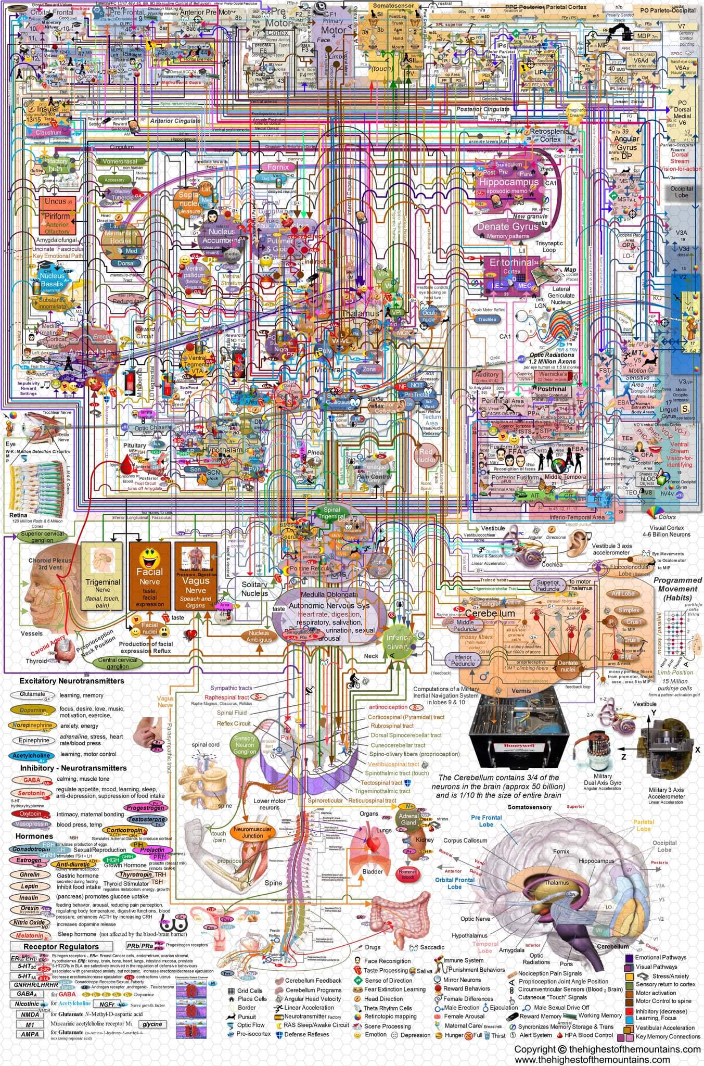
Confusing diagrams

Slide 21

Parking

Slide 22
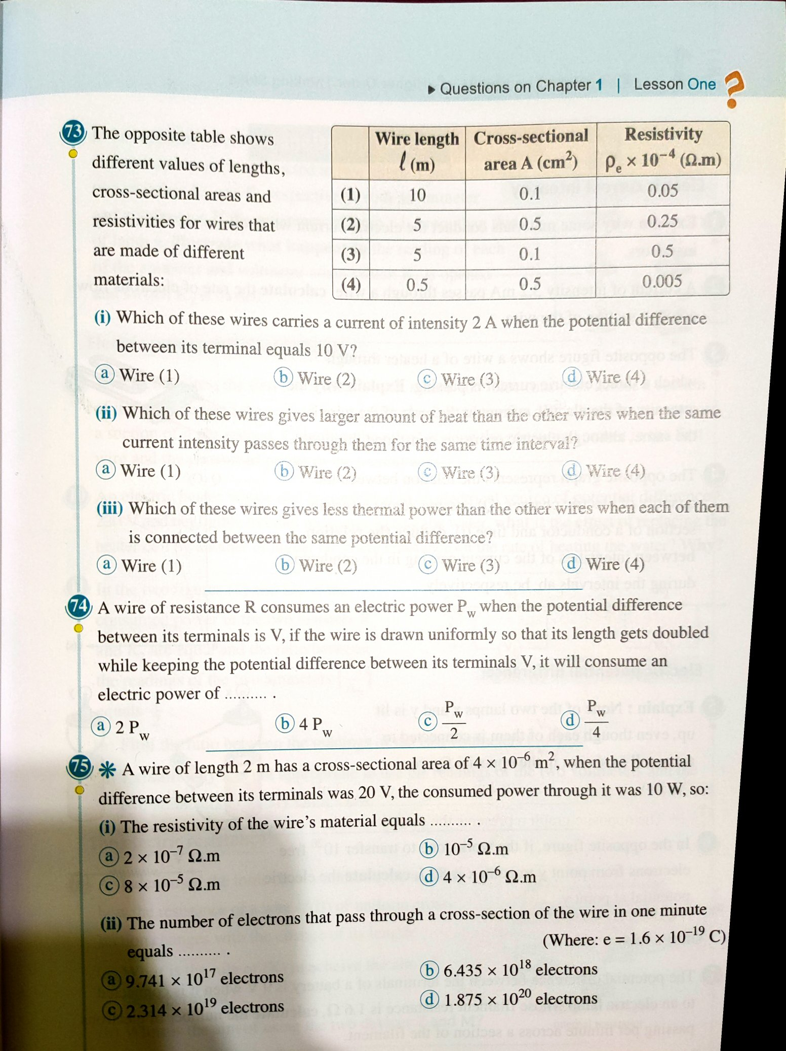
Homework

Slide 23

Cooking

Slide 24

Home Decor

Slide 25
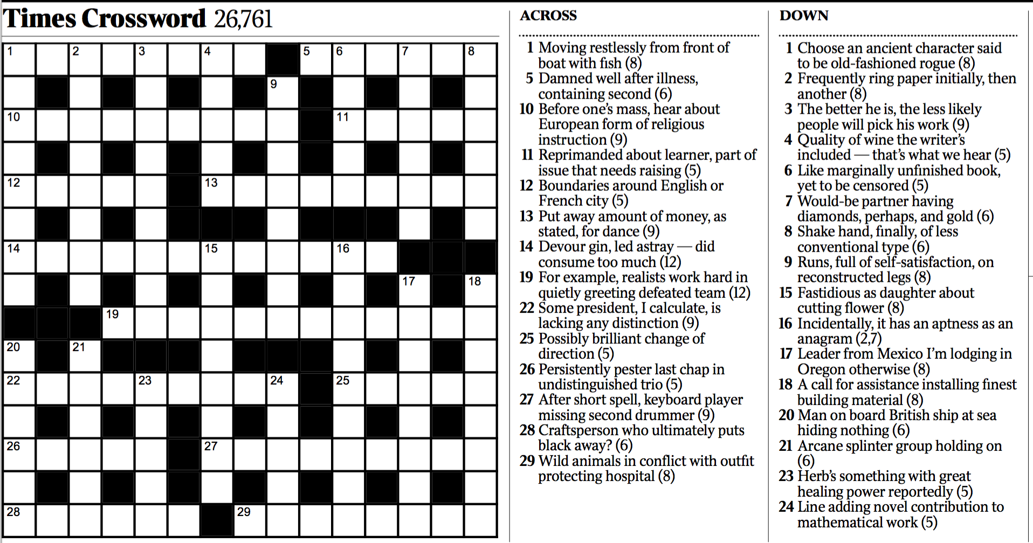
Crossword Puzzle

Slide 26

Picture puzzles

Slide 27

Poker

Slide 28
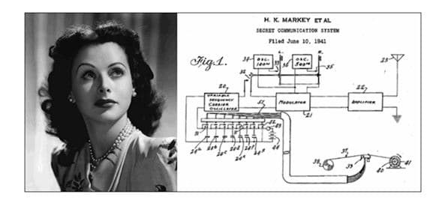
Relationships Between Images

Slide 29

Code

Slide 30


